Slide 1

Multiple Linear Regression on Used Car Market Data
Josh Rogers
MSDA Capstone

Slide 2

Introduction:
Analyst: Josh Rogers
Role: Reporting Compliance Analyst
Purpose: Analyze and identify key features impacting used vehicle pricing
Method: A multiple linear regression model aimed to predict what variables impact used vehicle pricing differentials

Slide 3
Problem Statement and Hypothesis
Problem
With rising car prices, buyers are becoming more likely to select used vehicles over new (Natani, 2022).
Understanding what factors influence price differentials, the different between actual sale price and predicted value as determined by the Manheim Market Report (MMR), can help stakeholders make better pricing decisions.
By identifying the key contributors to price differential this research can serve as a data-driven approach to facilitate fair market pricing.
Hypothesis
The hypothesis is that key features, such as make, model, body, transmission, year, condition, and odometer, significantly contribute to the price differential of used cars.

Slide 4
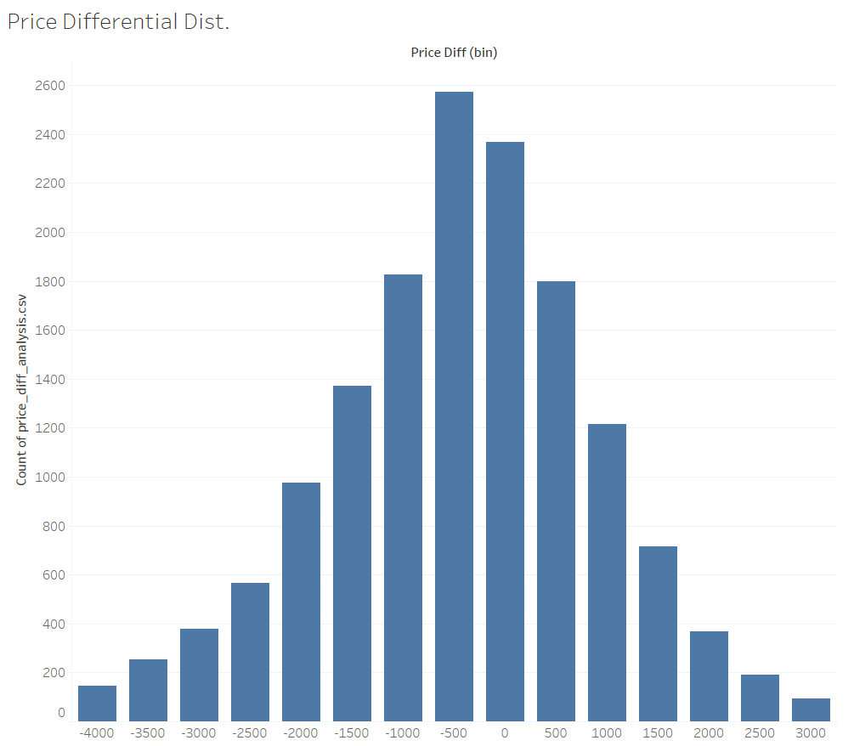
Summary of the Data Analysis Process
Data Source:
The dataset used in this study was sourced from Kaggle’s “Vehicle Sales Data” containing 25,000 rows of information.
Features considered: make, model, body, transmission, year, condition, odometer, and price differential
Data Preparation:
The data was cleaned by removing blank values, eliminating outliers, encoding categorical variables, and standardized to reduce noise.
Techniques:
Multiple Linear Regression
Lasso Regression for feature selection

Slide 5
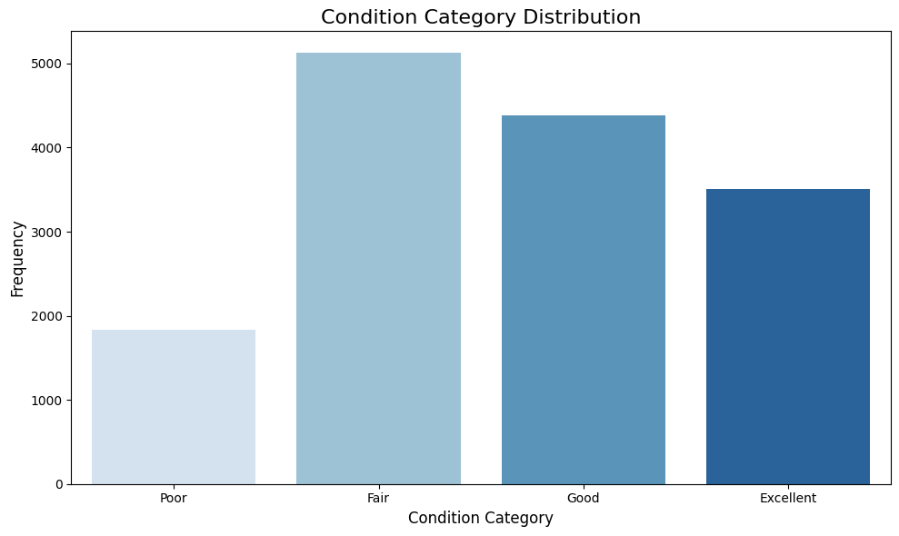
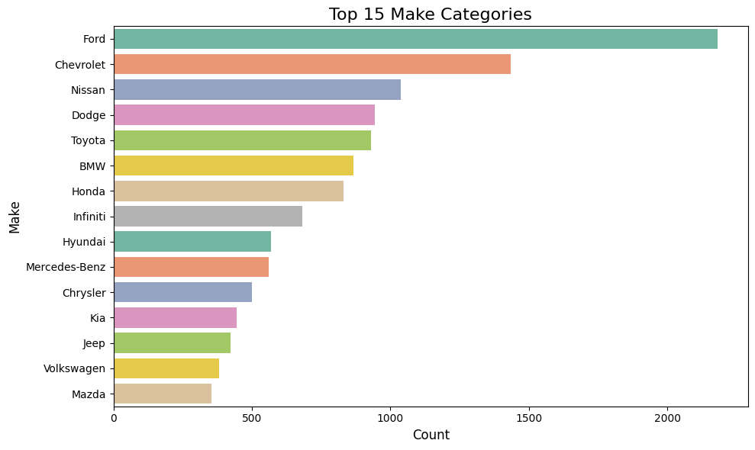
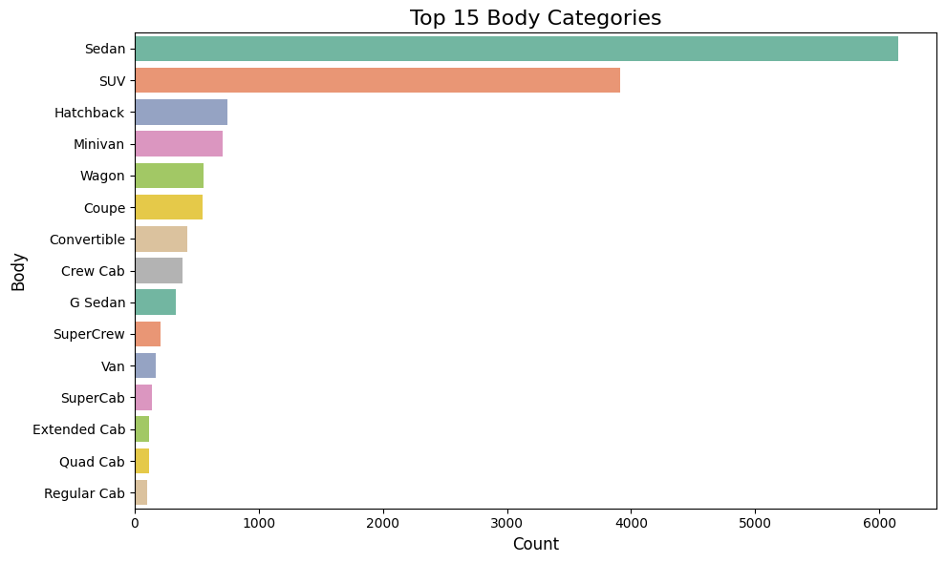
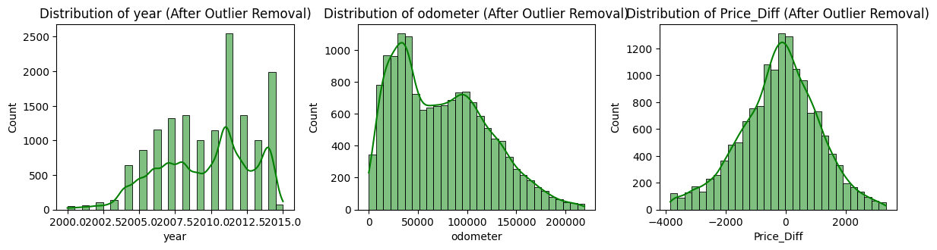

Slide 6
Summary of Findings
Positive Influences (Increase Price_Diff):
make_Porsche: +$635.88 — Porsche vehicles are associated with a significantly higher price difference.
make_HUMMER: +$629.57 — Hummer vehicles also tend to fetch higher prices.
body_G37_Convertible: +$2229.63 — This body style adds a large premium to price difference.
make_Honda, Kia, MINI, Nissan, Mazda, Mitsubishi, Jeep: All have positive coefficients ranging from +$122 to +$315.
Negative Influences (Decrease Price_Diff):
body_Cab_Plus_4: -$2591.25 — This truck body style significantly lowers price difference.
make_Maserati: -$2674.12 — Surprisingly, Maseratis are associated with a lower price difference.
condition_encoded: -$161.44 per unit increase — Worse condition = lower price difference.
odometer: -$0.0015 per mile — Higher mileage decreases the price.
transmission_manual: -$261.79 — Manual transmission reduces price difference.

Slide 7
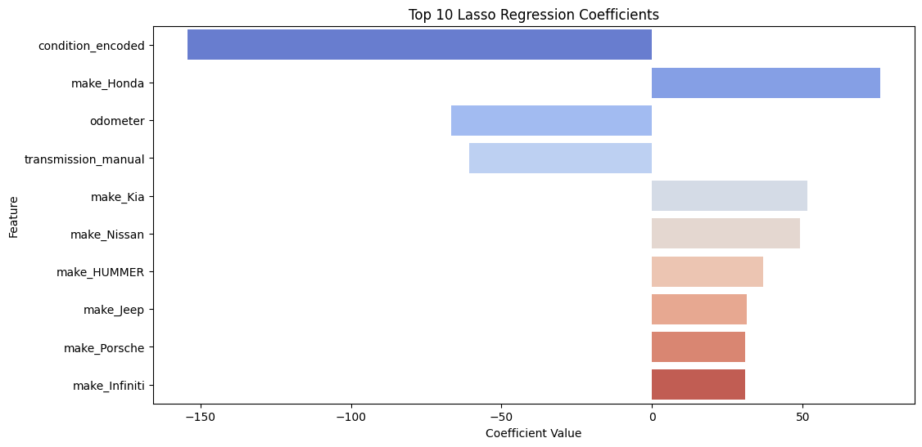
Most Influential Features on Price Differential
make_Honda (+75.62): Hondas are associated with a significantly higher price difference.
make_Kia (+51.44), make_Nissan (+49.17), make_HUMMER (+36.90), make_Jeep (+31.38), make_Porsche (+30.98), make_Infiniti (+30.89): These brands tend to increase the price difference, suggesting that they retain more value or have higher resale prices.
condition_encoded (−154.19): The strongest negative factor. Worse condition strongly reduces the price difference.
odometer (−66.82): More mileage = lower price. This is a major driver of price drop.
transmission_manual (−60.74): Manual cars tend to fetch lower resale prices.

Slide 8

Limitations
Multiple Linear Regression assumes a linear relationship between the predictors and the target variable. Data with nonlinear relationships can limit model accuracy.
Lasso regression has the potential of dropping important features arbitrarily.
The original dataset contained additional features such as seller, date, interior, color, state, and trim, that were excluded from the initial model due to high computational demands. These variables may contribute valuable insights and could potentially improve the model’s predictive power if considered. Additionally, the dataset initially included over 550,000 rows; however, reduction was required for similar processing considerations.

Slide 9
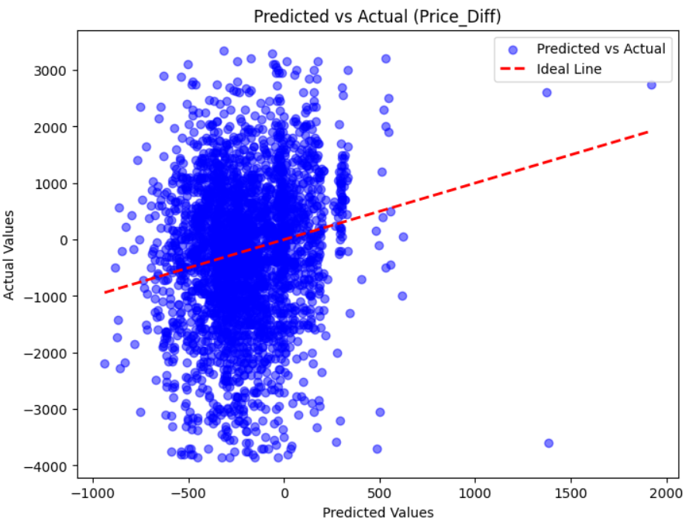
Accuracy:
The significant scattering of the points suggestion a high level of prediction error. This information is consistent with the calculated R-squared value of 0.028, which means that the model only explains about 2.8% of the price differential variance.
Meaning:
The results indicate that additional variables not included in the model may be influential predictors. Future development may include trying nonlinear models and/or further reduction and regularization techniques

Slide 10
Next Steps…
Even though it would demand more computational power, the inclusion of more variables like state, color, and interior could be considered.
1
The implementation of nonlinear models like random forest or decision trees can be utilized.
2
Reconsider values eliminated by Lasso regression and those that were omitted based on their P-values.
3

Slide 11
Conclusion
The initial model found some relationships between car features and price difference: however, the overall predictive power of the model was low. The model struggles to make accurate predictions even though certain patterns could be identified.
Key takeaways:
Condition matters: Cars in worse condition tend to sell for lower prices.
Brand effects: Certain brands like Honda, Kia, Nissan, and Porsche showed a slight positive influence on price, while others like Maserati and some truck models had negative impacts.
Mileage matters: As a car's mileage increases, its price decreases.
Transmission type: Manual cars were slightly less valued compared to automatic ones.

